Slide 1



Sales per Country
View in Power BI
Last data refresh:
1/19/2022 10:42:15 AM UTC
Downloaded at:
1/19/2022 11:37:53 AM UTC

Slide 2
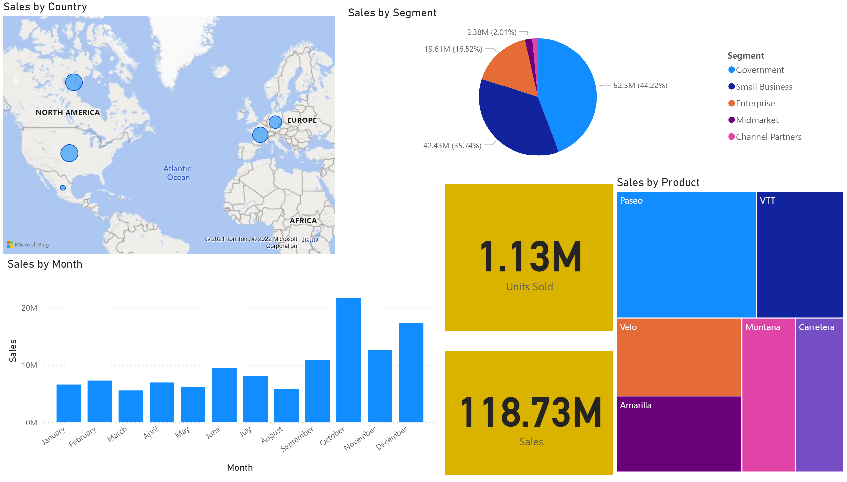
Page 1
Notes:
map
No alt text provided
pieChart
No alt text provided
card
No alt text provided
card
No alt text provided
clusteredColumnChart
No alt text provided
treemap
No alt text provided

